Slide 1
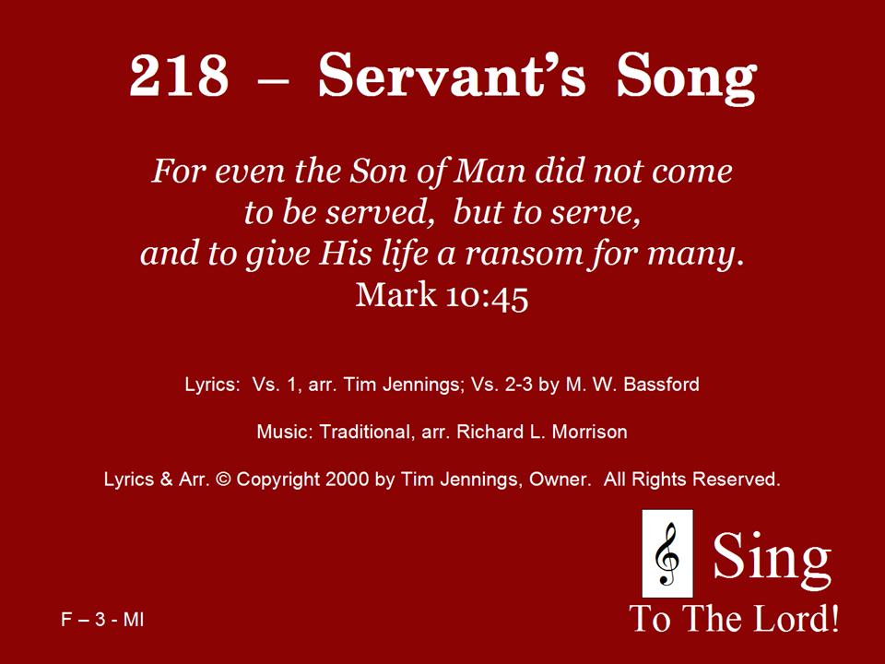
218 - Servant's Song - Title

Slide 2
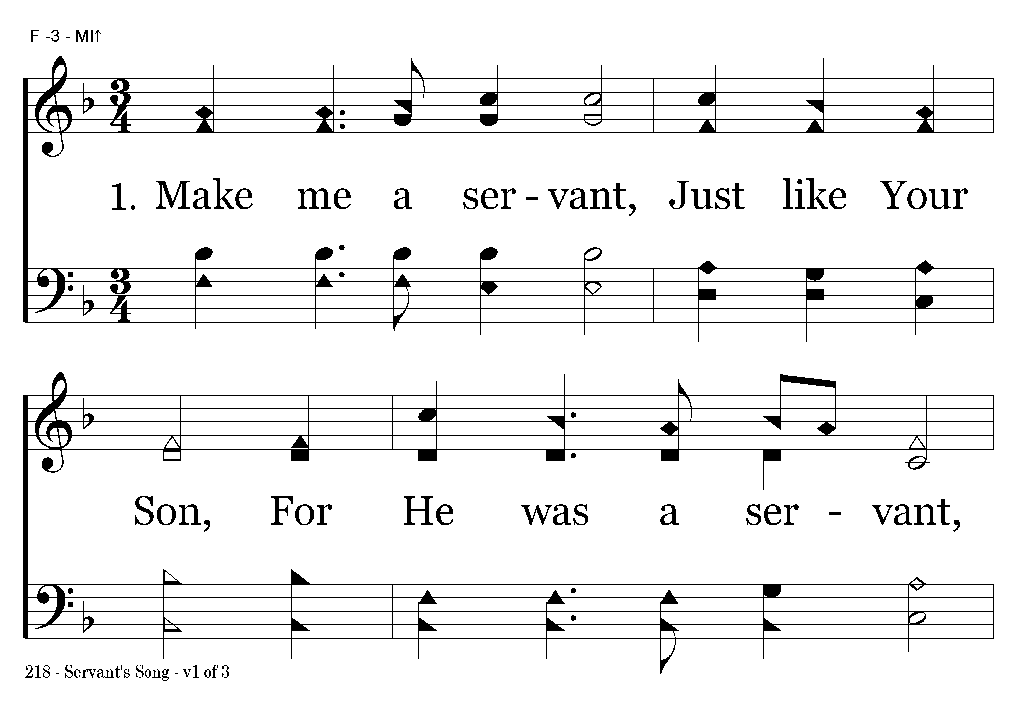
218 - Servant's Song - 1.1

Slide 3
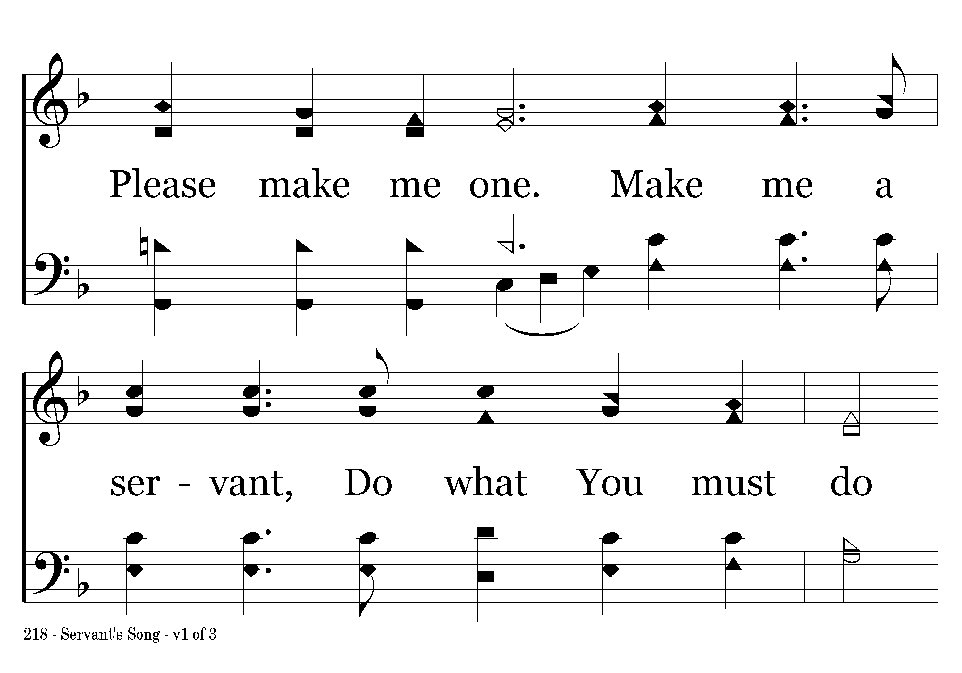
218 - Servant's Song - 1.2

Slide 4
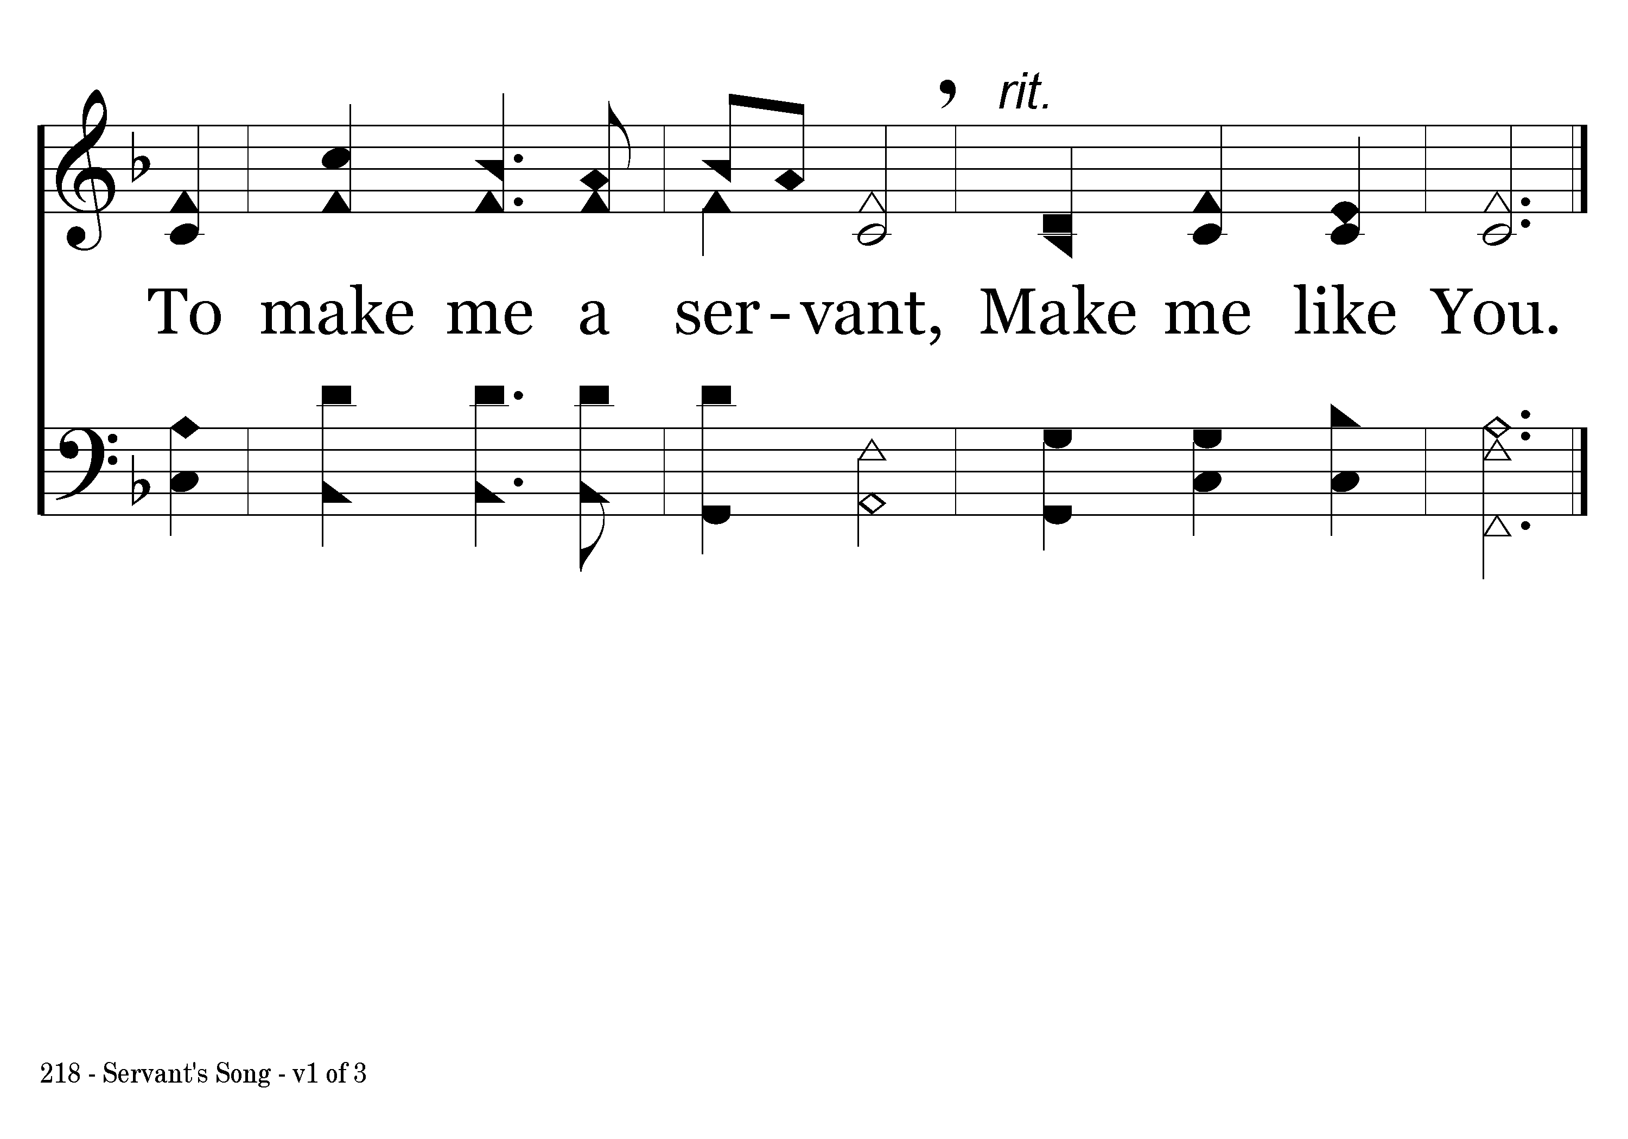
218 - Servant's Song - 1.3
End of Verse 1

Slide 5
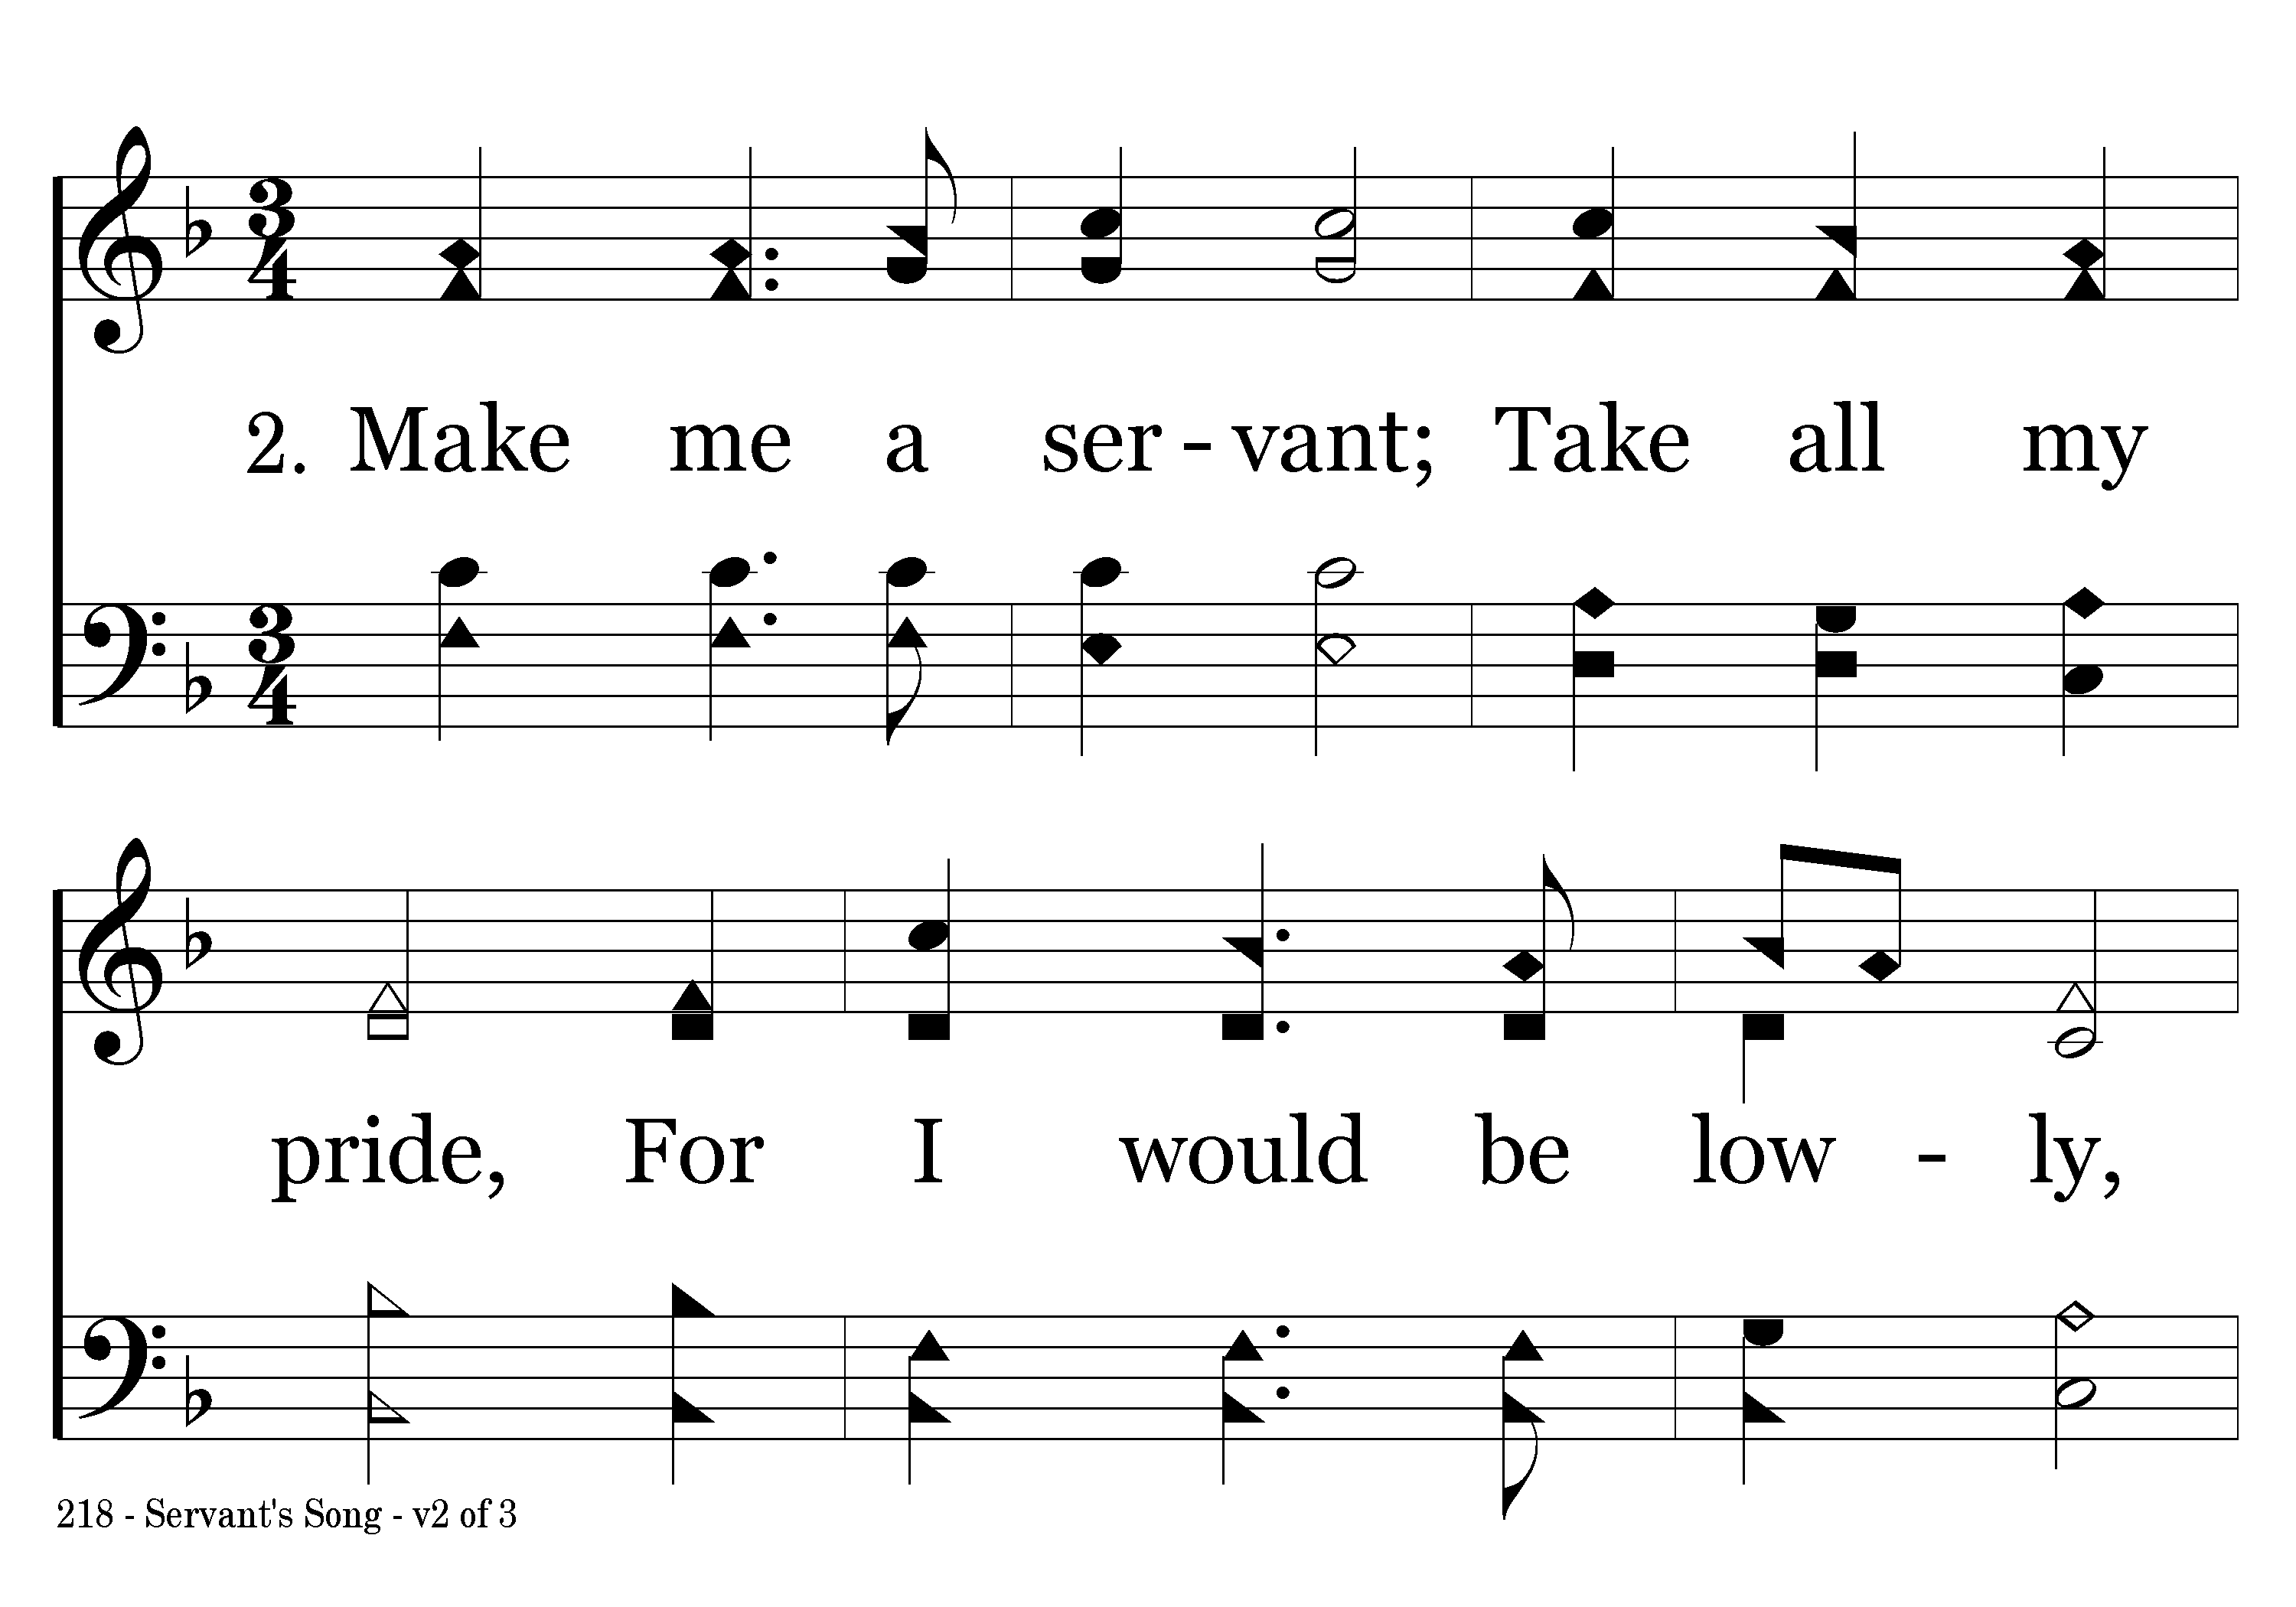
218 - Servant's Song - 2.1

Slide 6
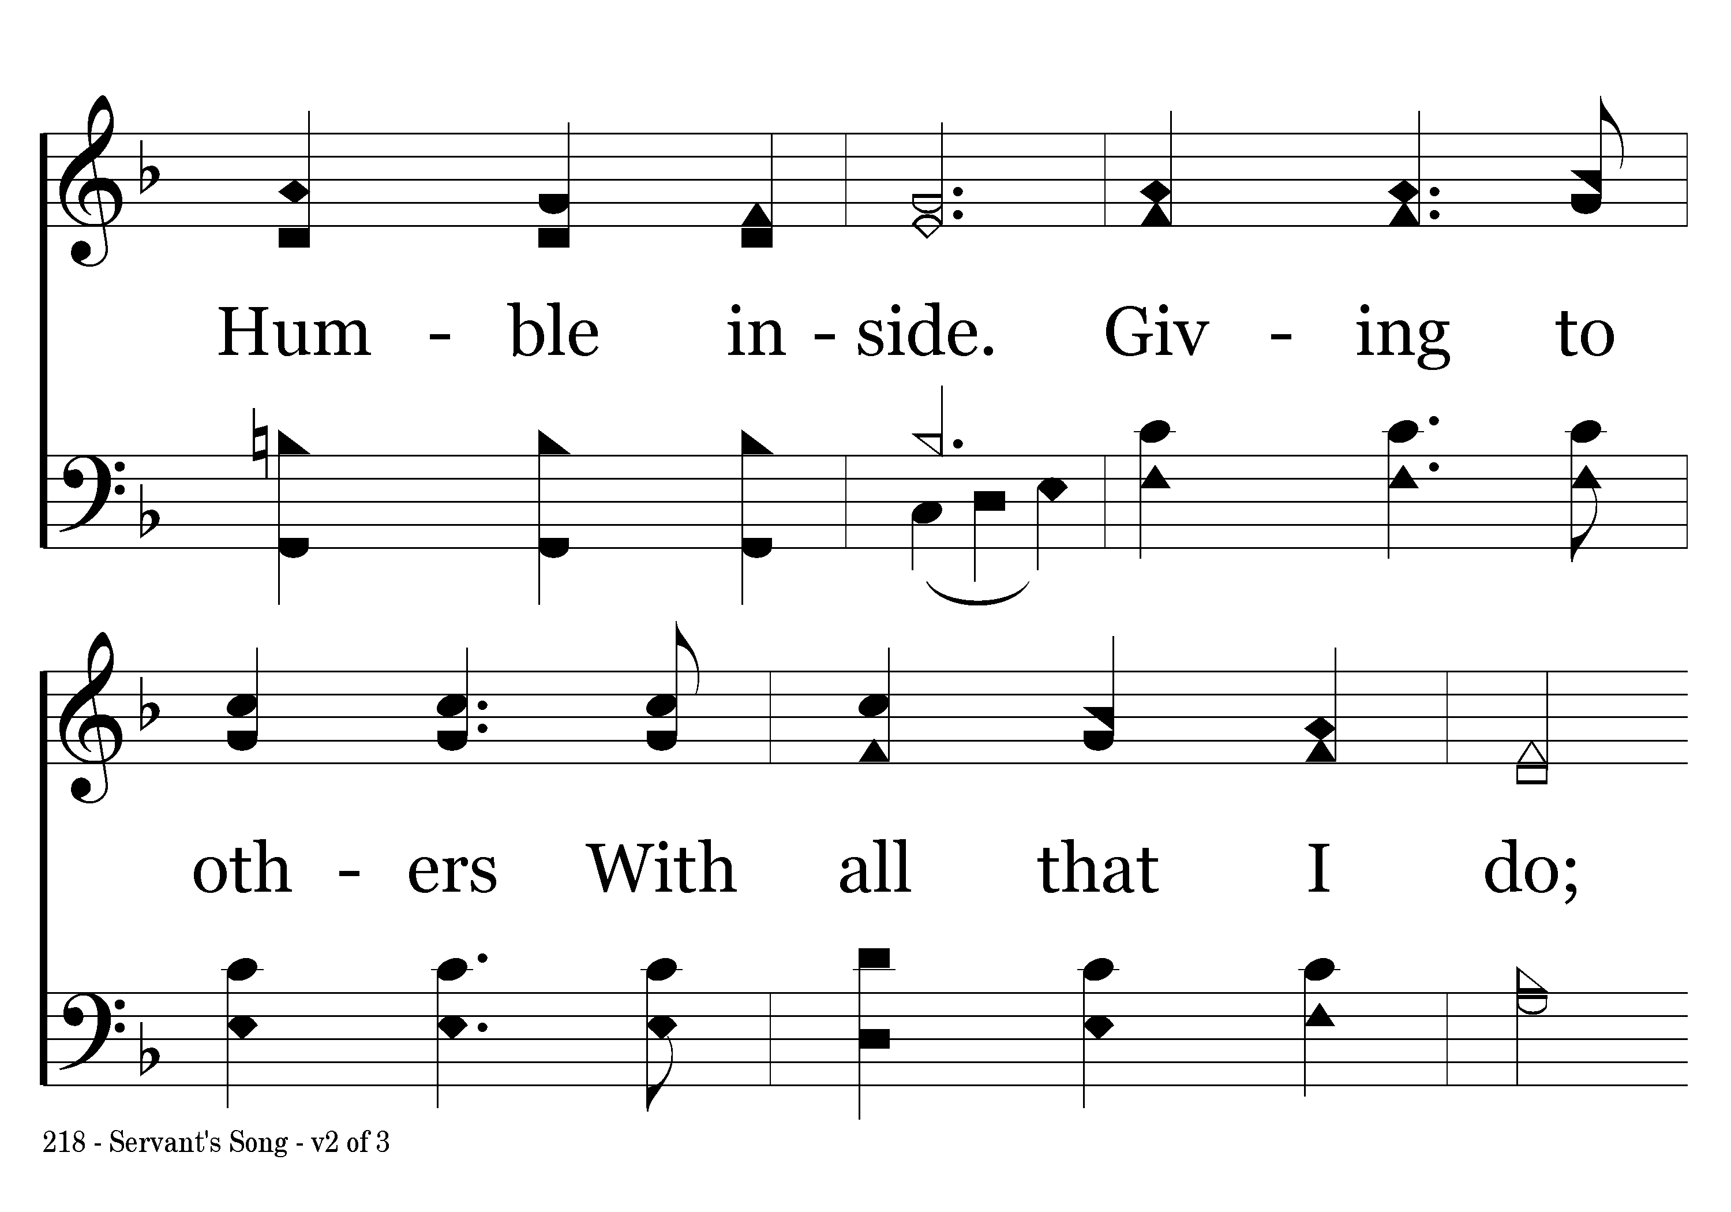
218 - Servant's Song - 2.2

Slide 7
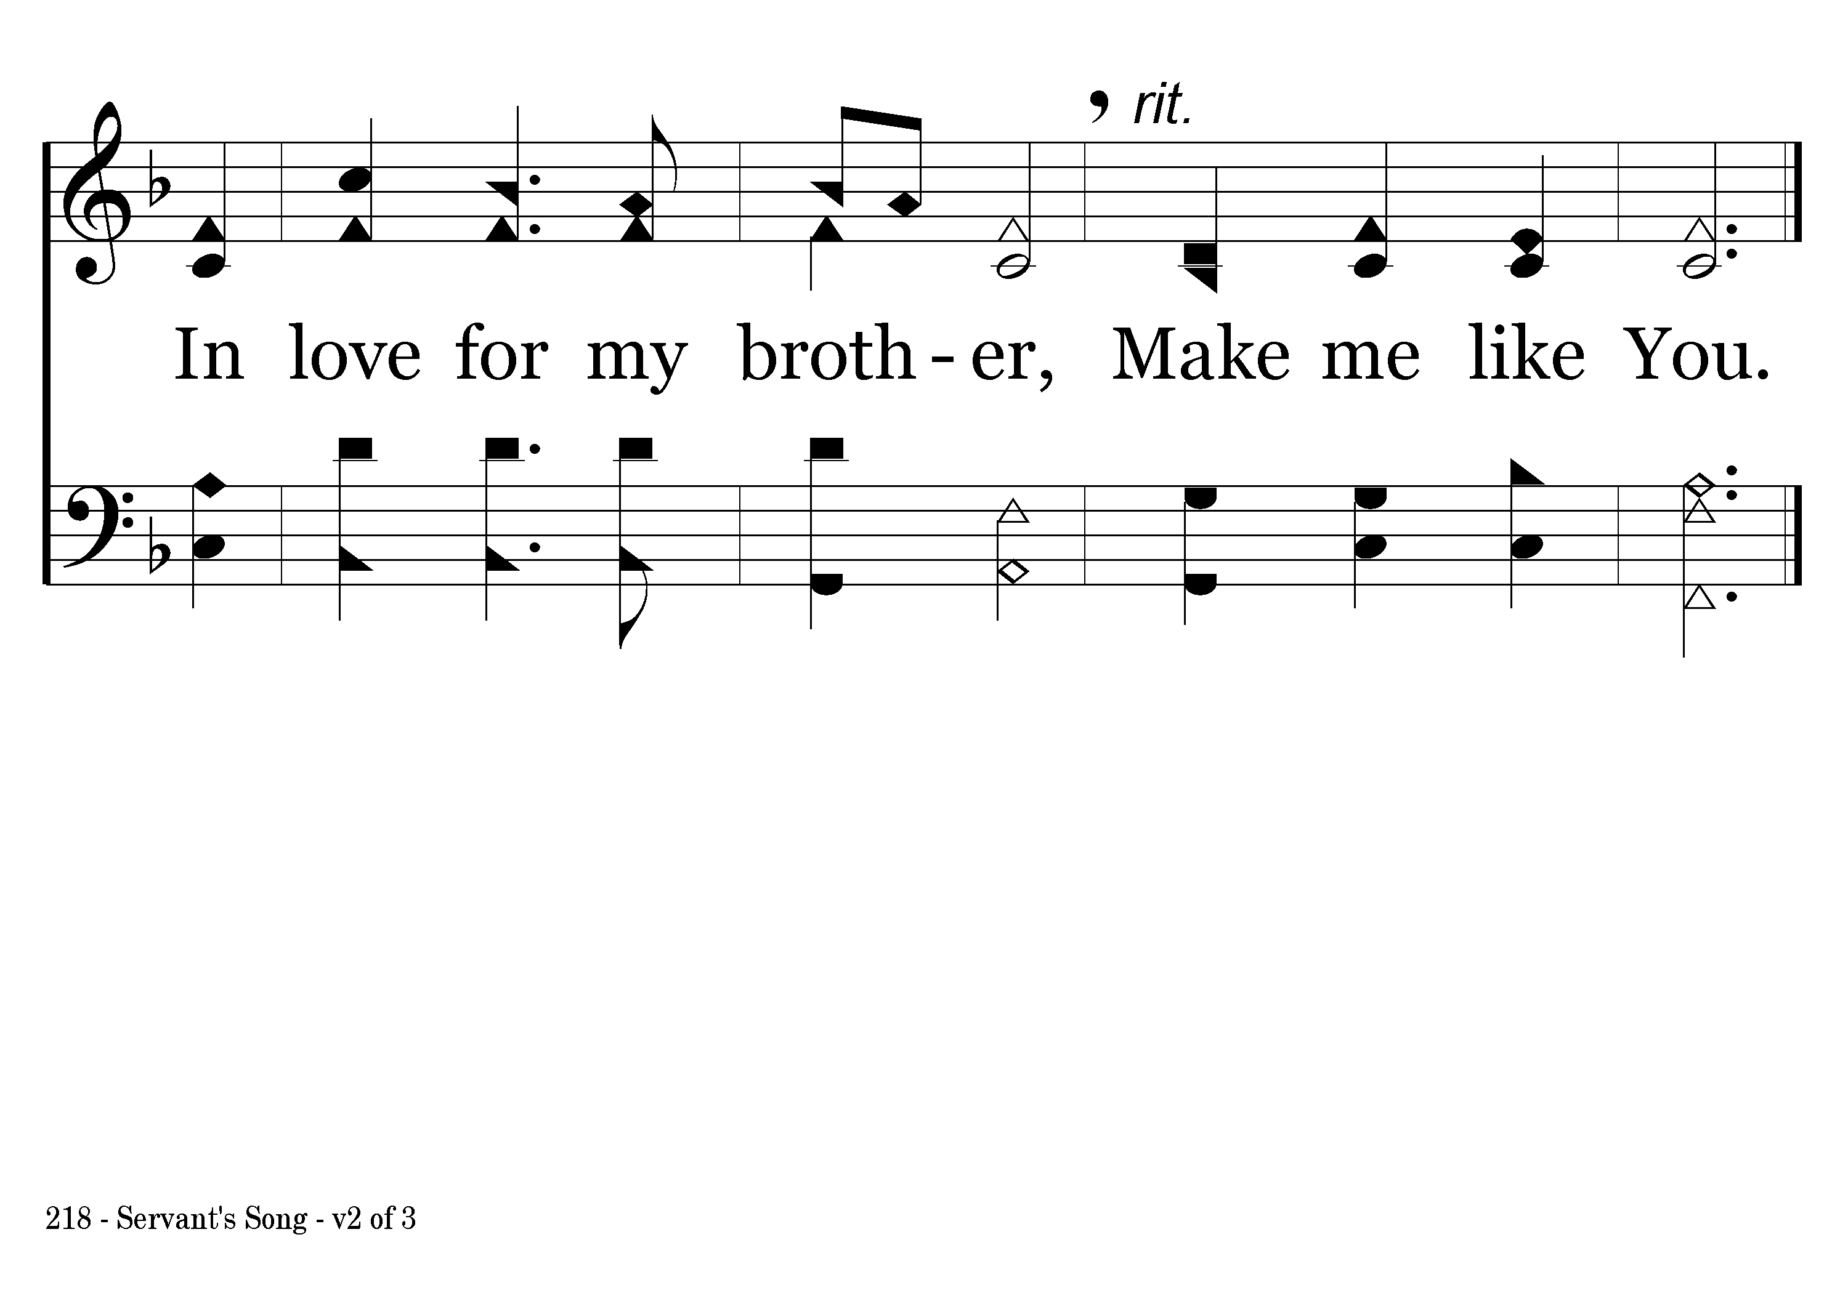
218 - Servant's Song - 2.3
End of Verse 2

Slide 8
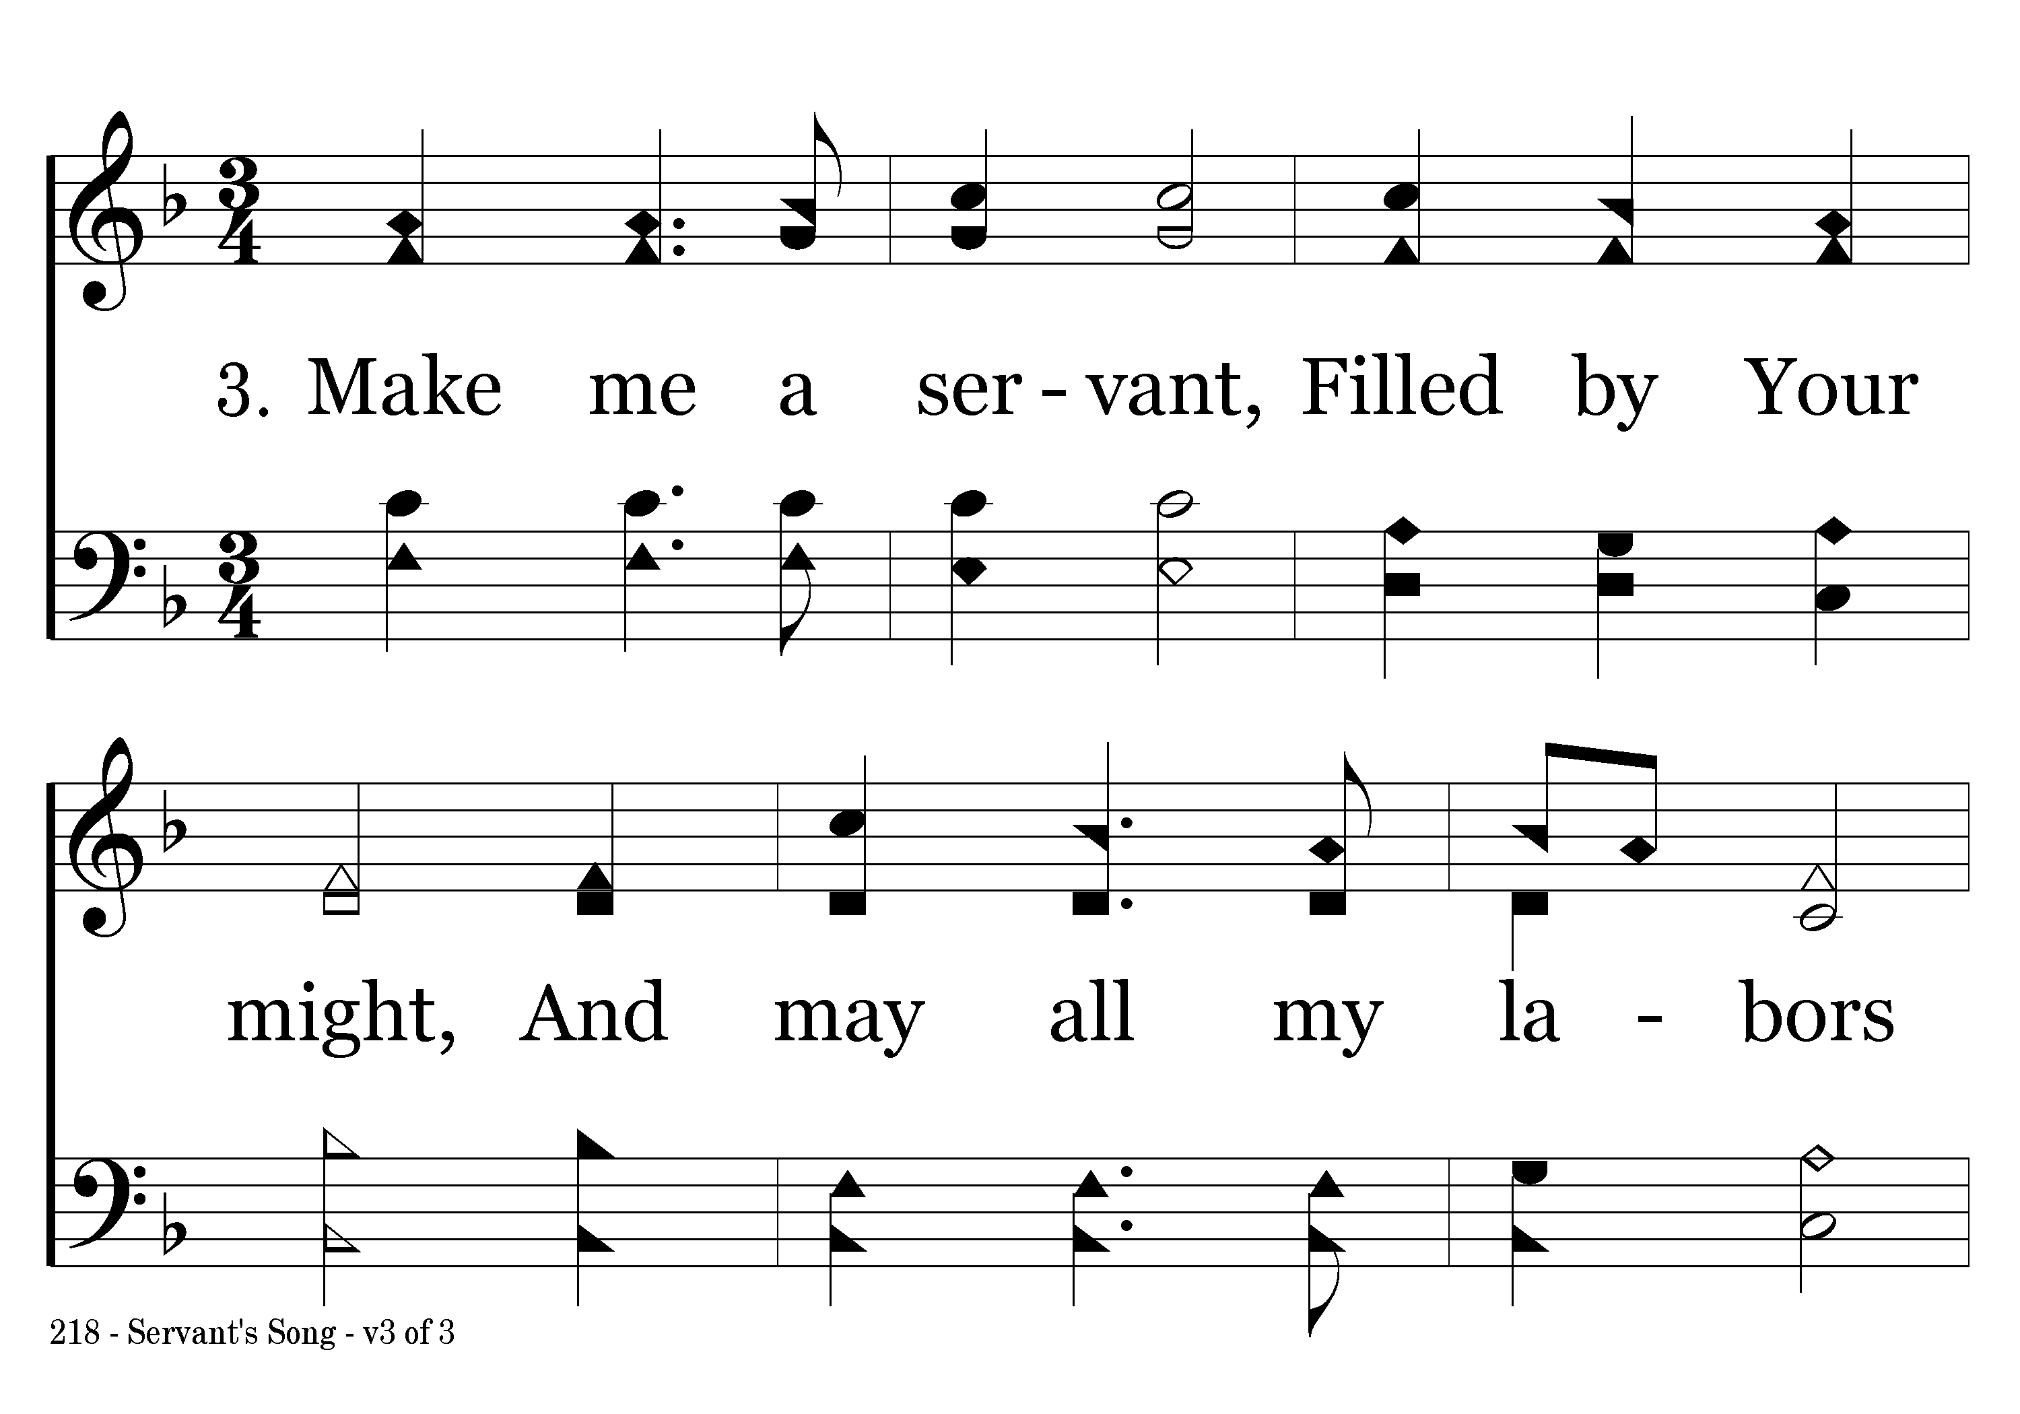
218 - Servant's Song - 3.1

Slide 9
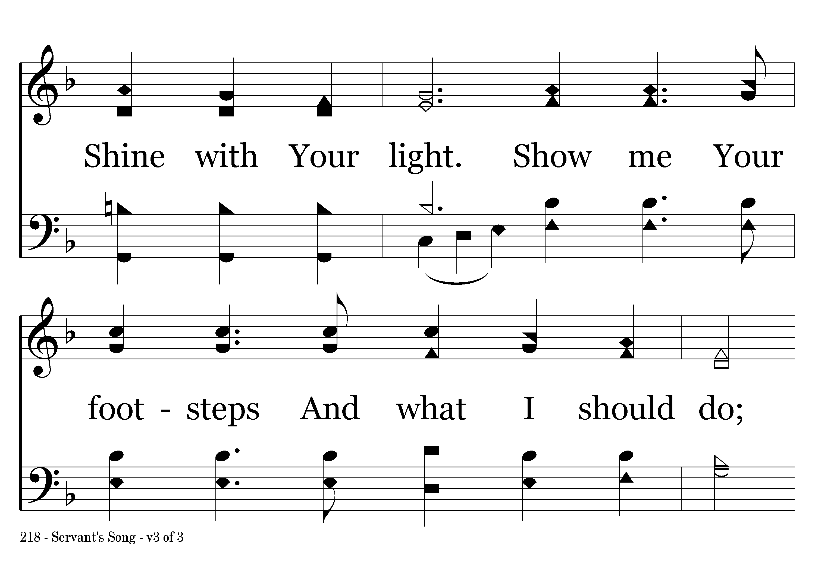
218 - Servant's Song - 3.2

Slide 10
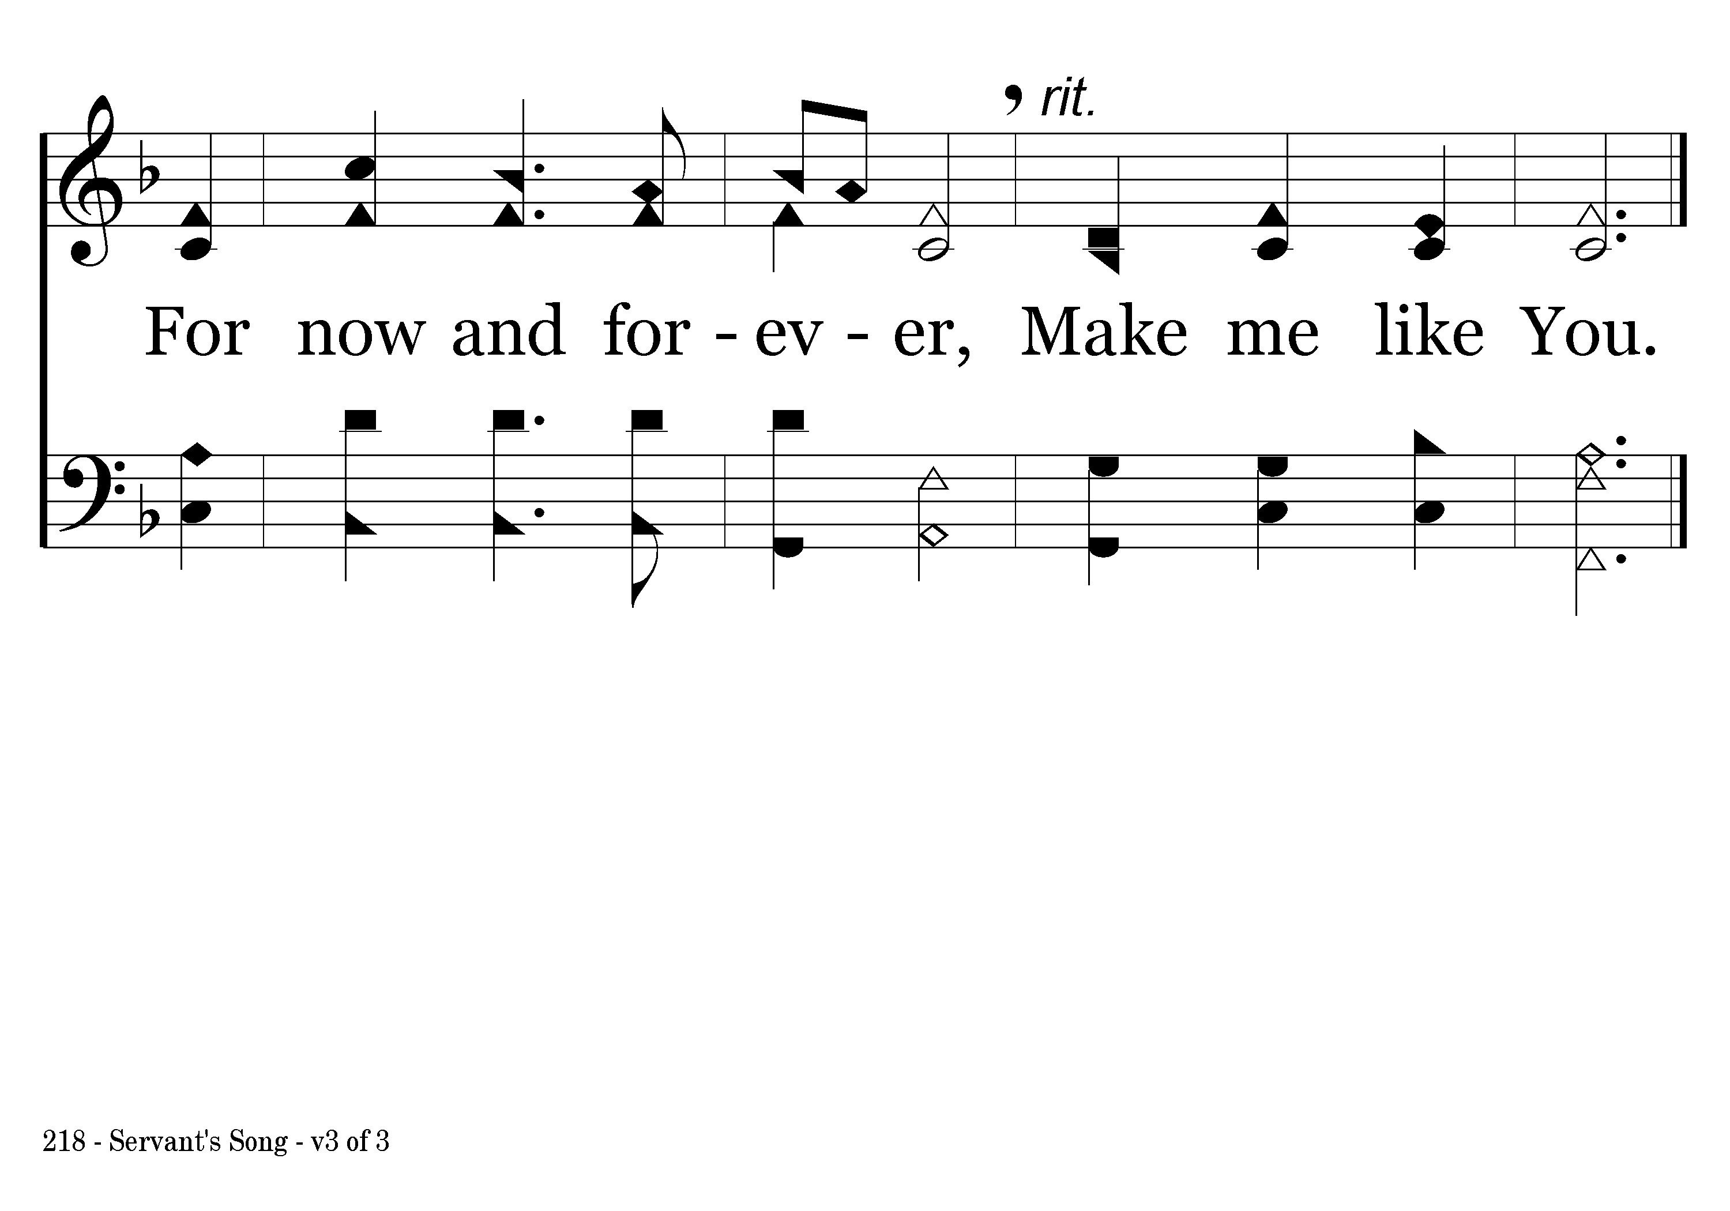
218 - Servant's Song - 3.3
End of Song

